Slide 1
Chapter 14
The Inquiry Training Model: Improving Questioning Skills and Analysis of Evidence

Slide 2
The Inquiry Training Model Rationale
Developed by Dick Suchman in the 1960’s.
To raise consciousness about causal reasoning.
To teach a strategy for resolving puzzling problems by formulating causal hypotheses based on information and identification of variables.
To provide a meta-analytic frame of reference for studying one’s modes of problem solving and how to improve them.

Slide 3
From Cognitive and Social Psychology
Confronted with something puzzling, something that conflicts with current understanding, people are motivated to resolve the conflict.
Thus, presenting students with a “discrepant event,” gets their attention. What might they do next?

Slide 4
To solve a problem requires that the information in the problem setting and events be obtained and clarified.
Then, variables need to be identified and clarified.
Explanations or hypotheses can then be generated, and tested – seeing which inferences or hypotheses have the most persuasive warrants under them.

Slide 5
Design
Suchman designed a format for lessons that constitute laboratory exercises.

Slide 6
Design (Cont’d)
Students are presented with a discrepant event through a demonstration, a film, or a reading. Several examples are provided in Chapter Fourteen.
They ask questions and the instructor responds in much the same fashion as the parlor game “twenty questions.”
The instructor frequently reframes questions, guiding the students toward inquiring into facts, developing variables, and developing hypotheses based on information and in terms of variables.

Slide 7
Learning to Inquire
After several sessions, students become more adept at collecting data and proceeding to frame possible causal relationships – their inquiry becomes more disciplined.
They become more aware of how they think.

Slide 8
Learning to Inquire (Cont’d)
They reduce “jumping to conclusions” and defending ideas through rhetoric rather than investigation.
When inquiry training has been part of their “thinking repertoire,” they find problems and discrepancies on their own.
As they master the process, they can take leadership in inquiry training sessions in their classroom.

Slide 9
Place in the Curriculum
Inquiry training is part of a curriculum, not a stand-alone model.
The outcomes are applicable to virtually all curriculum areas. Sessions can be interrupted while information is sought.
Works best above the primary level, but some teachers do very will with primary students.

Slide 10
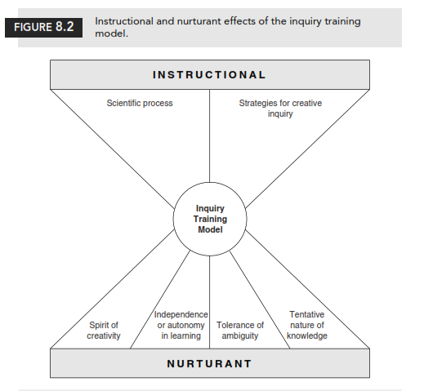
Figure 14.2 Instructional and Nurturant Effects of the Inquiry Training Model

Slide 11
For the Instructor
Planning needs to include assembling a collection of discrepant events, puzzling problems, and questions appropriate for students of different levels.

