Slide 1
Chapter Nine
Using Advance Organizers to Design Presentations

Slide 2
David Ausubel developed the advance organizer model to
  * Increase thinking and feeling when receiving presentations, including lectures but also multimedia combinations, dramatizations, and print fiction and nonfiction.
  * Essentially, he believed that “reception” learning episodes need not be passive but should be active.

Slide 3
Scaffolds for the Mind
The essence of the model is the use--at the outset of a presentation--of a structure of ideas called Advance Organizers.
The recipient is to study the organizer and then relate the content of the presentation to the ideas in the organizer.
During a unit in a course or a workshop, discussions can be guided by the scaffold provided by the organizer.

Slide 4
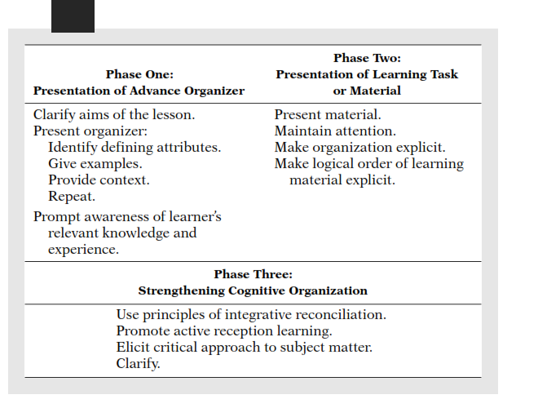
Table 9.1 Syntax of the Advance
Organizer Model

Slide 5
For the instructor or presenter, the hard work is building the organizer-–using the highest level concepts that bind the content together.

Slide 6
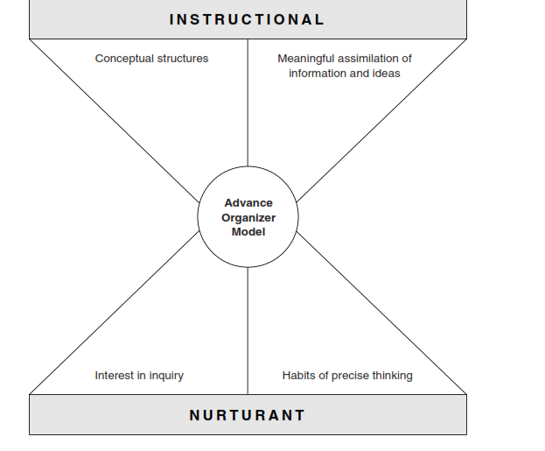
Figure 9.3 Instructional and Nurturant Effects of the Advance Organizer Model

Slide 7
Development of Organizers is Crucial
In addition to the examples in Chapter 9, most of the other chapters in Models of Teaching begin with an “organizing idea.”
To build your advance organizer, examine the material that you are going to present to your students or that you are asking them to read, watch, or listen to.
Think of the material conceptually: what are the major binding concepts essential for understanding the content and/or processes being presented.

