Slide 1
Chapter Eight
Memorization:
Getting the Facts Straight, Now and for the Long Term

Slide 2
Helping Long-Term Memory Happen
There’s nothing wrong with getting something into short-term memory except that it goes away.
Remember last-minute cramming for a test? Getting through the test (luckily) but, a few weeks later, not much of the crammed stuff is left.
As we teach, we want the students to master the content so that it is in their minds for
a very long time.

Slide 3
Thinking about Thinking
Research on memory has led to the idea of “meta-cognition.” That is, thinking about what you are doing and how to do it well pays off.
As you read Chapter Eight, prepare to practice the principles developed from research and created by people who taught themselves to become expert at obtaining and retaining information of all sorts.

Slide 4
Important Tip!
To teach mnemonics principles, you need to practice them yourself. You will understand them better if you use them. You will also collect examples you can use with students.

Slide 5
Principles – Basic
Good memorizers use some straightforward processes, not exotic ones. Here are five of them: they work together:
Attending!
Reviewing!
Summarizing
Rehearsing!
Building Associations!

Slide 6
Attending!
They pay attention to the content they are learning!
They review constantly – and re-review what they have missed. They think about what they are learning.

Slide 7
Reviewing
Good memorizers go over content again, as many times as is necessary for the material to “feel” familiar.
Reading a book, they will reread passages. Looking at a film, they may watch scenes more than once.
Who, where, what, when, and how is imprinted in their minds and works as an overarching screen as they review.

Slide 8
Summarizing
Good memorizers summarize regularly as they study. The act of summarizing helps clarify and reinforce what is being learned, maintains awareness of the task of learning, and guides reviewing, helping to confirm who, when, where, what, how!
Take a look at Chapter Fifteen, comprehension when reading is facilitated by summarizing regularly.

Slide 9
Rehearsing
Good memorizers constantly rehearse retrieving content. In a sense, they quiz themselves periodically.

Slide 10
Building Associations
Separate bits of information are much harder to retain than organized information.
Categorizing builds concepts that glue smaller items together. Relating new information to previous learning helps. Making even one dramatic connection helps us remember some information or an idea.
Good memorizers categorize and connect.

Slide 11
Attending, reviewing, rehearsing, summarizing, and building associations keep the objective of learning and retaining content conscious.

Slide 12
Can other models help us gain information and ideas and retain them?
Think about it?
For openers, consider
* Inductive Thinking
* Scientific Inquiry
* The Picture Word Inductive Model
* Concept Attainment
How might each of these increase retention?

Slide 13
Can other models help us gain information and ideas and retain them?
Keep thinking. Consider
* Synectics
* Advance Organizers
* Explicit Instruction and Metacognition
* Group Investigation
How might each of these increase retention?

Slide 14
Well used, all models
have a mnemonic effect,
and
mnemonic principles
also enhance
the other models of teaching.

Slide 15
Practice works! Mnemonic processes can help strengthen your learning capacity!
Practice, practice . . . and practice some more.

Slide 16
Good Memorizers know it is their job to learn, rather than the instructor’s job to persuade them to learn or entertain them in the process.
The mnemonic principles not only help us memorize, they can make learning more interesting.

Slide 17
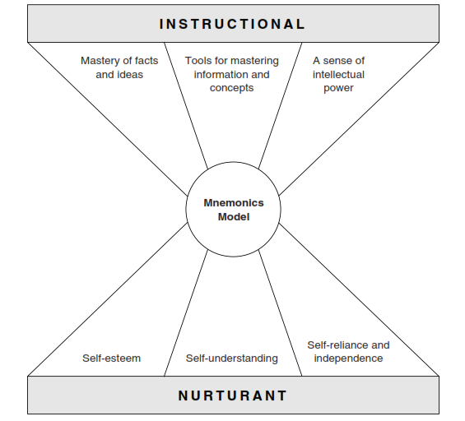
Figure 8.3 Instructional and Nurturant Effects of the Mnemonics Model

