Slide 1
Chapter Six
The Picture Word Inductive Model
(PWIM)

Slide 2
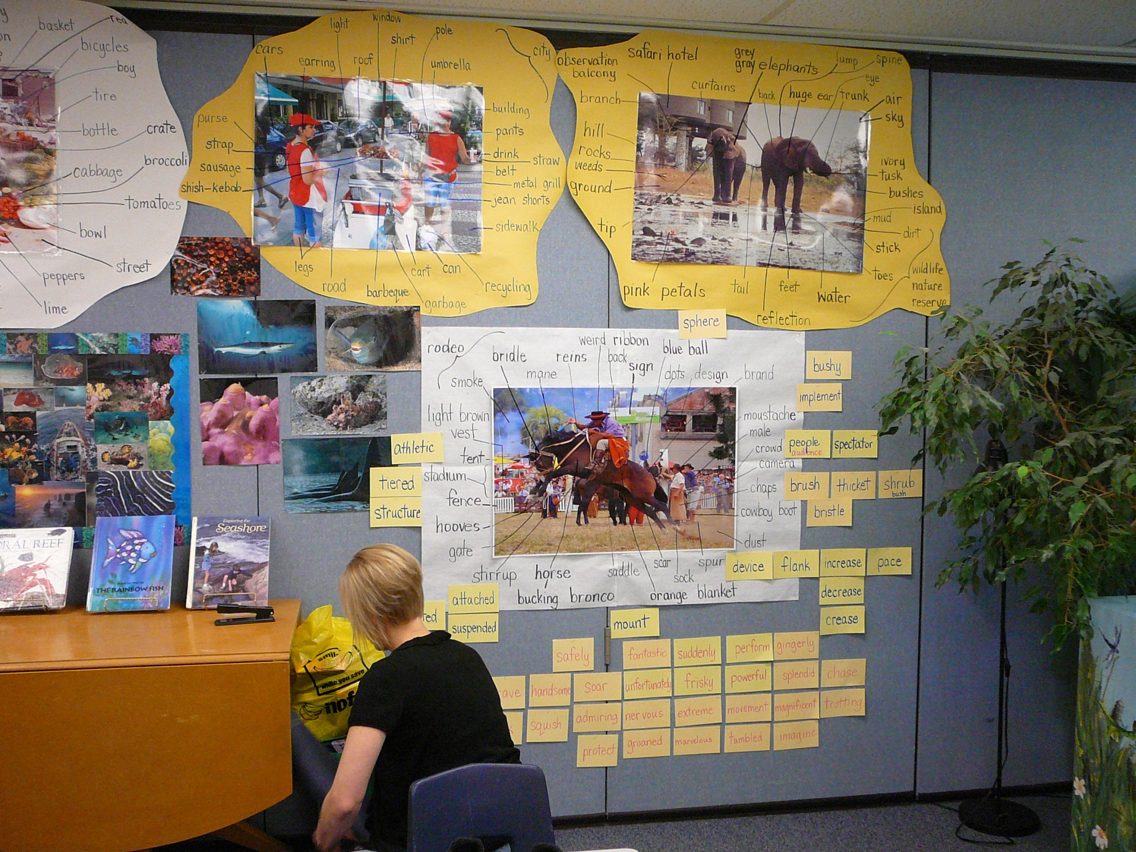

Slide 3
Let’s begin in a classroom
The wall let’s us know that this first-grade classroom is one of those where PWIM is a major part of learning to read and write.
Watch Emily Calhoun’s demonstrations with kindergarten children on www.modelsofteaching.org and follow the phases of the model as those students begin reading and analyzing words.

Slide 4
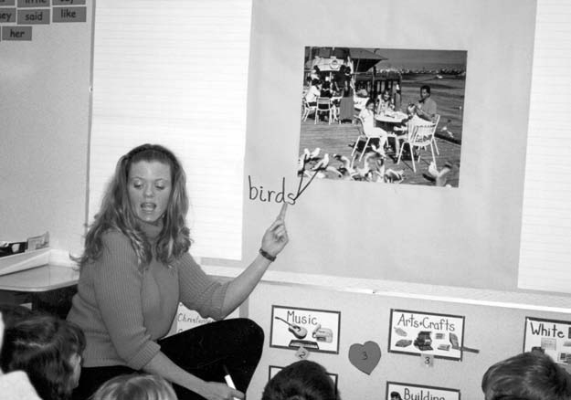
PWIM Cycles begin as the students study a picture and identify objects and actions that they name – these are spelled out on the chart.

Slide 5
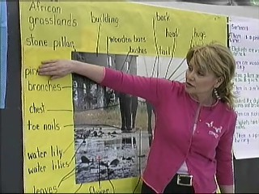
They study those words – letters, sounds, syllables, meanings.

Slide 6
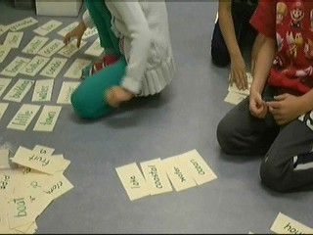
They classify the words, building categories based on word properties.

Slide 7
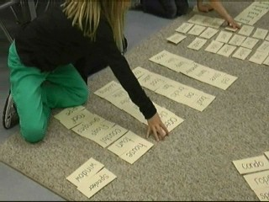

Slide 8
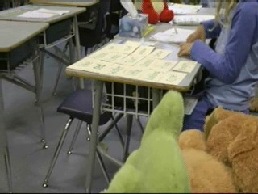

Slide 9
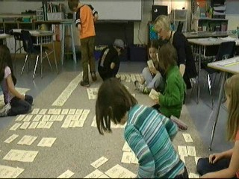

Slide 10
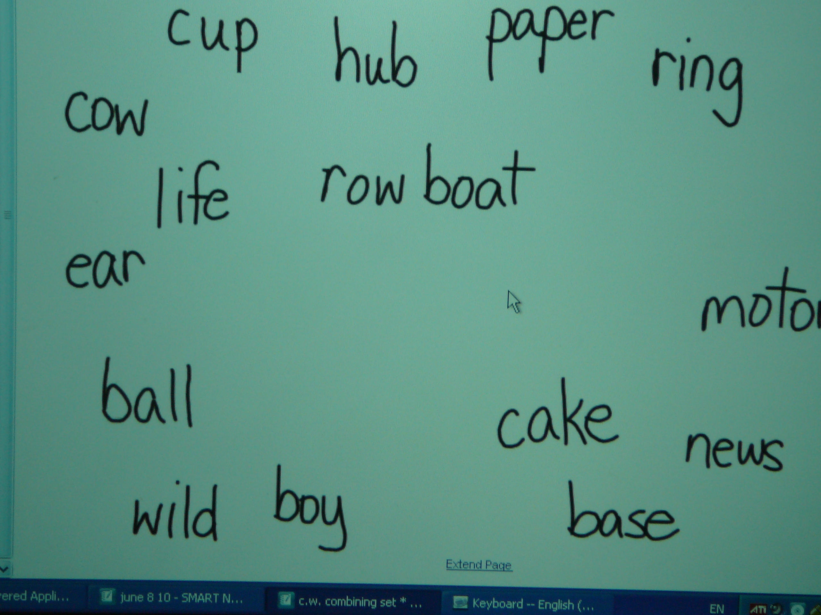
Or they classify by moving words around the Whiteboard.

Slide 11
The words find their way into charts
. . . .

Slide 12
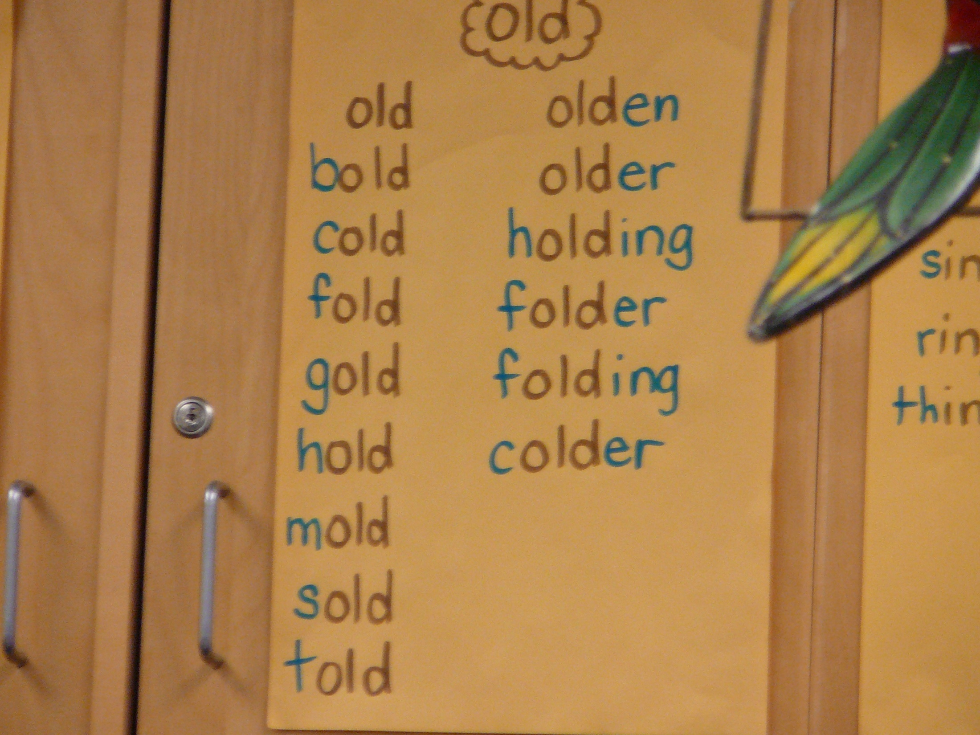

Slide 13
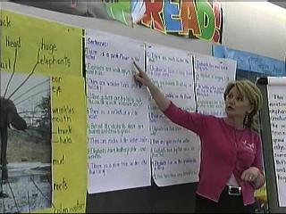
The teacher models building sentences using those words. She adds “little useful words” as needed.
Then the students make and share sentences by dictating them.

Slide 14
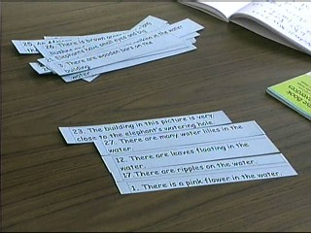
And, then the sentences are studied and classified.

Slide 15
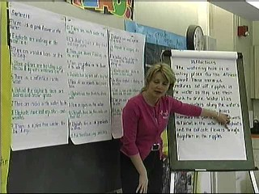
The teacher models composing a paragraph from a category of sentences.

Slide 16
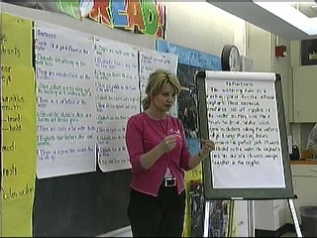
She models several times, then the students arrange sentences into paragraphs and share them.

Slide 17
The electronic whiteboard is a great aid for use with many models.
In PWIM, it
makes sharing word categories easier
makes sharing and reading student sentences easier
(and printing sets for students!)
makes modeling the use of text structures and
organizational patterns for reading and writing
much easier for students to see when the teacher
or they do reading comprehension or writing
think alouds.
is great for demonstrating editing and revising.
makes . . .

Slide 18
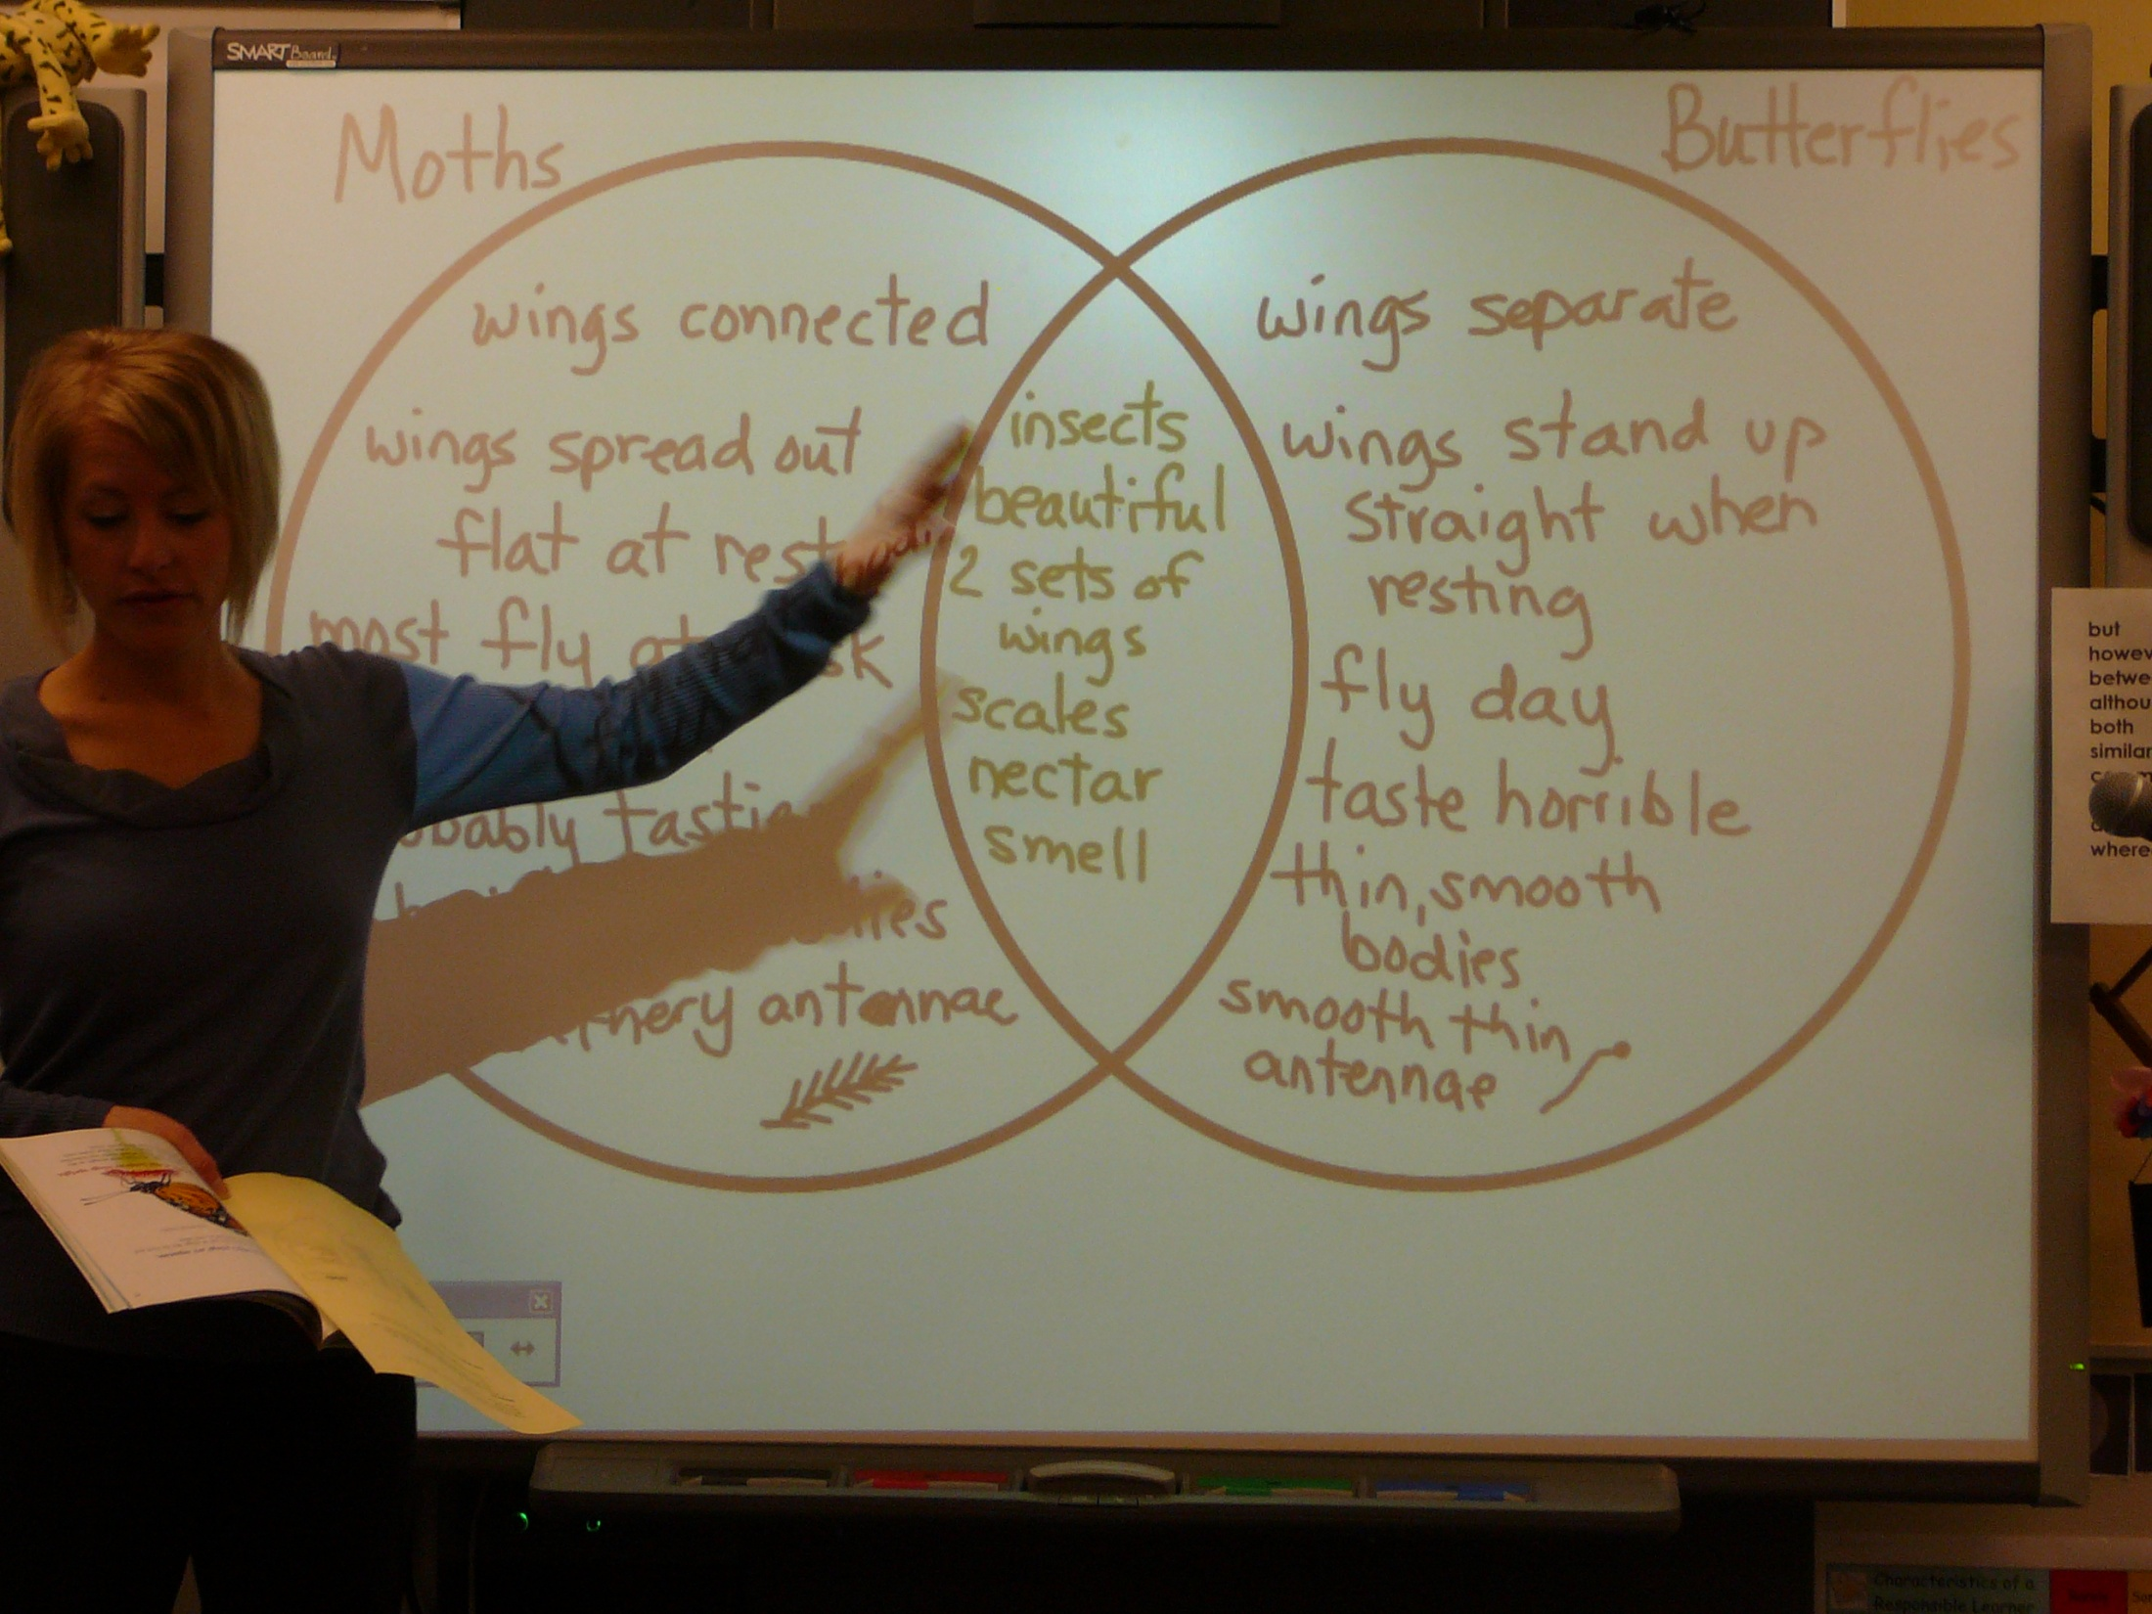
Sometimes they use Venn diagrams after reading multiple texts and before writing . . . .

Slide 19
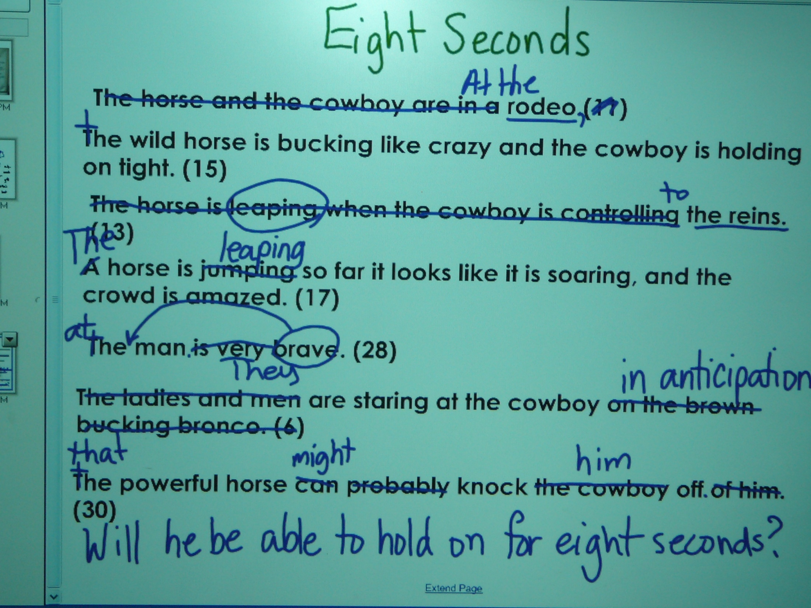

Slide 20
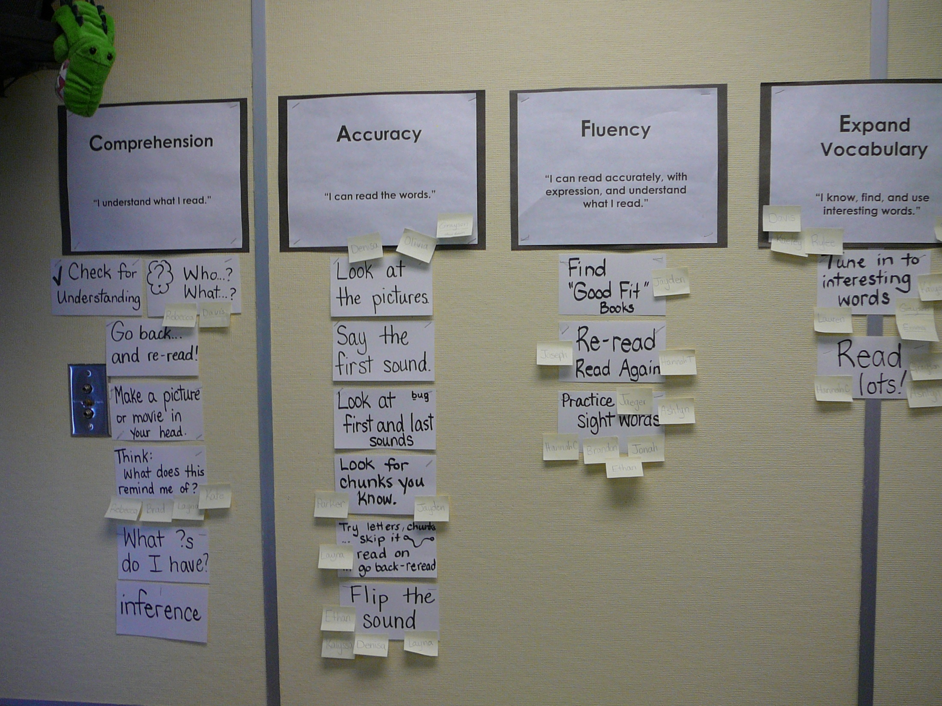

Slide 21
Teachers select pictures that relate to the curriculum units or concepts their students are studying.
One PWIM cycle follows . . . and another . . . and another . . . .

Slide 22
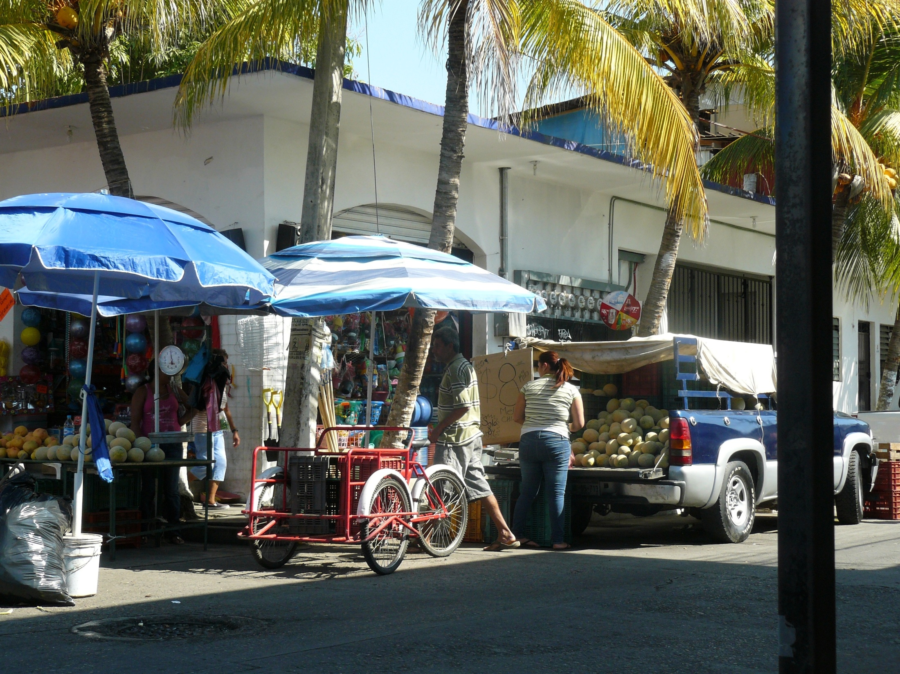

Slide 23
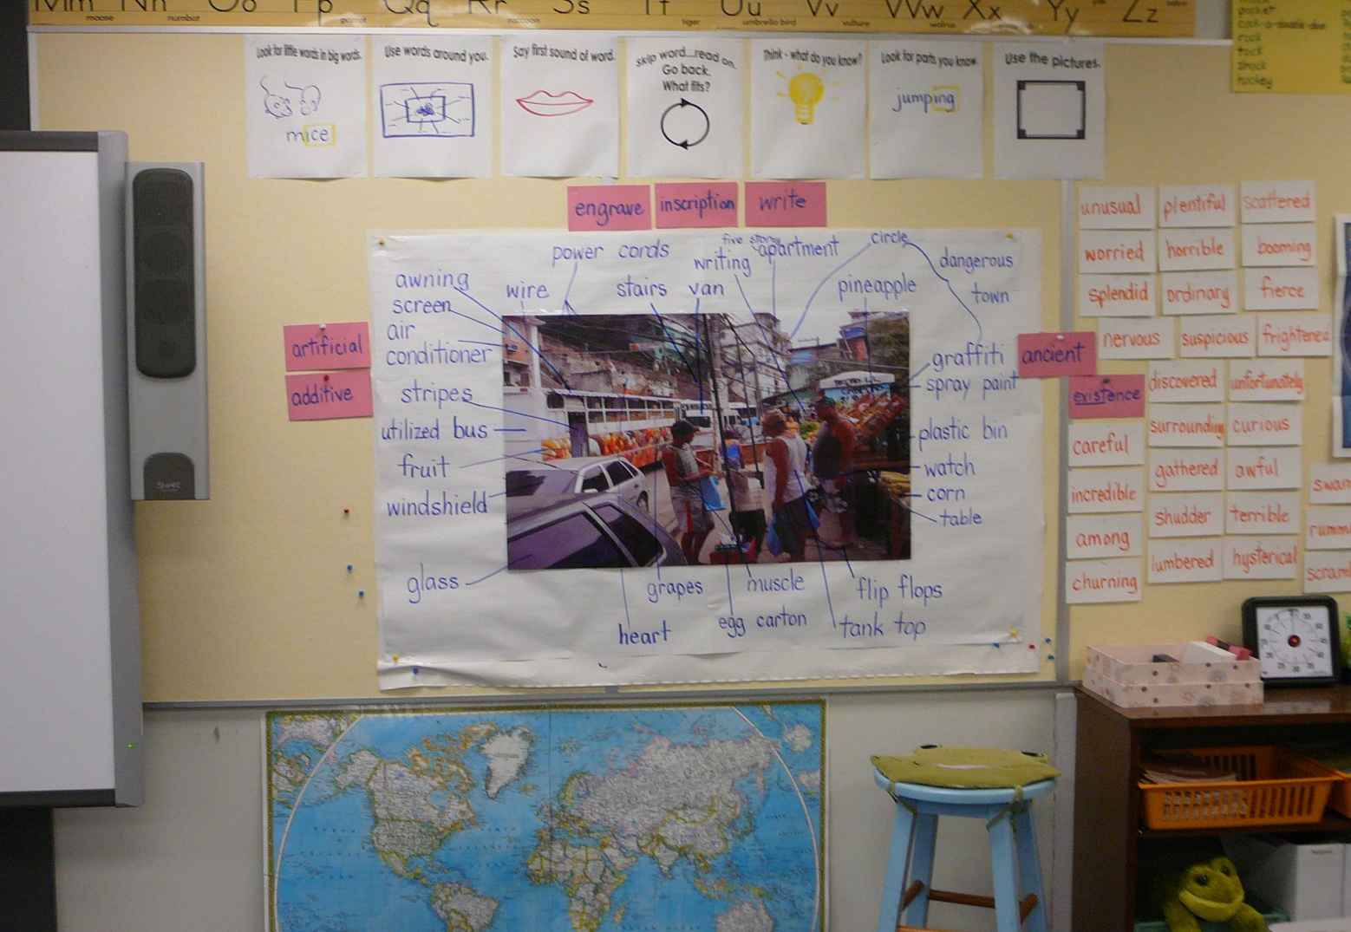

Slide 24
Sequence of the Picture Word Inductive Model (PWIM)
1. Select a picture.
2. Have students identify what they see in the picture.
3. Label the picture parts identified. (The teacher draws a line from the picture to the word, says the word, spells the word and points to each letter with a finger or marker, says the word again, and students spell the word with the teacher.)
4. Read/review the picture-word chart.
5. Have students classify the words into a variety of groups. Identify common concepts in the words to emphasize with the class as a whole. The students “read” the words by referring to the chart if the word is not in their sight vocabulary.
6. Add words, if desired, to the picture-word chart and to
the word banks.

Slide 25
7. Have students think of a title for their picture-word chart.
(The teacher leads students to think about the “evidence” and
information in their chart and about what they want to say about
this information.)
8. The teacher models writing sentences about the picture, using a
composing think-aloud process.
9. Have students generate a sentence, sentences, or a paragraph
directly related to the picture word chart.
10. The teacher then students classify group-generated sets of
sentences.
11. The teacher models putting the sentences together into a good
paragraph.
12. The students write or dictate paragraphs.
(Modified from Table 6.1 Summary Chart for the Picture Word Inductive Model.)

Slide 26
Part of the PWIM Rationale
Links students’ natural listening-speaking language directly to print.
Students inquire from the beginning – starting with studying a picture and identifying objects and actions in it. The words they “shake out” of the picture become part of the content of instruction.
The focus is on evidence—whether studying the photograph, word properties, gathering related words from picture books, or writing about the photograph or topic.

Slide 27
Figure 6.12 Instructional and Nurturant Effects of the
Picture Word Inductive Model

