Slide 1
Chapter Four
Scientific Inquiry: Building Learning Around Investigations

Slide 2
Investigation is central - I
The content of science is inextricably connected with the processes by which it was created.
And much of that content is best understood in terms of the type of investigation from which it emerged.

Slide 3
Investigation is Central - II
Teaching science means teaching investigation.
Beginning in kindergarten, or earlier, and never-ending.

Slide 4
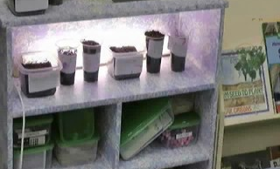
A First Grade investigates ….

Slide 5
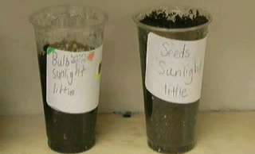
planting seeds under different conditions.

Slide 6
Process-oriented science teaching
Works in all curriculum areas …
Increases learning and retention of content …
Improves capacity to learn and solve problems …
Leads to mastery of academic methods for creating knowledge and concepts.

Slide 7
The Academy of Sciences
Take a look at the paper on which the science/engineering/technology curriculums were developed.
National Research Council (2012). A Framework for K-12 Science Education Practices, Crosscutting Ideas, and Core Ideas. Washington, D.C.: The National Academies Press.

Slide 8
Additional Resources from the National Academies
National Academies of Sciences, Engineering, and Medicine. 2022. Science and Engineering in Preschool Through Elementary Grades: The Brilliance of Children and the Strengths of Educators. Washington, DC: The National Academies Press.
National Academies of Sciences, Engineering, & Medicine. (2019). Science and engineering for grades 6-12: Investigation and design at the center. Washington, DC: The National Academies Press.

Slide 9
Syntax of the Scientific Inquiry Model
Phase One: Pose a problem, area, or phenomena to be investigated.
Phase Two: Identify needed data and how to collect it.
Phase Three: Analyze the data—are conclusions warranted yet?—plan further data collection. Speculate on ways to clear up difficulties. And on, until the area has been thoroughly explored.
Phase Four: Develop explanations, models, solutions, and/or actions that address the phenomena/problem/area and reflect understanding.

Slide 10
FIGURE 4.5 Instructional and nurturant effects of the scientific inquiry model

