Slide 1
Learning by Investigating
Chapter Four

Slide 2
The Academy of Sciences
Take a look at the paper on which the science/engineering/
technology curriculums are being developed.
National Research Council (2012). A Framework for K-12 Science Education Practices, Crosscutting Ideas, and Core Ideas. Washington, D.C.: The National Academies Press.

Slide 3
Investigation is Central I
The content of science is inextricably connected with the processes by which it was created.
And much of that content is best understood in terms of the type of investigation from which it emerged.

Slide 4
Investigation is Central II
Teaching science means teaching investigation.
Beginning in kindergarten and never-ending.

Slide 5
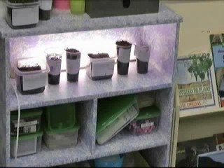
A First Grade investigates ….

Slide 6
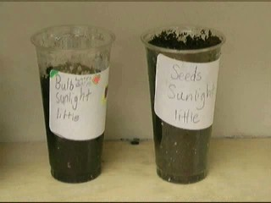
planting seeds under different conditions.

Slide 7
Process-oriented science teaching
Works in all curriculum areas …
Increases learning and retention of content …
Improves capacity to learn and solve problems …
Leads to mastery of academic methods for creating knowledge and concepts.

Slide 8
Syntax of Biological Science: Inquiry Model
Phase One Phase Two
Area of investigation is posed to Students structure the problem.
students.
Phase Three Phase Four
Students identify the problem in Students speculate on ways to
the investigation. clear up the difficulty.

Slide 9
